Slide 1
Person Centered Counseling Tools
Explained

Slide 2
What PCC Looks Like During a Call
Ask questions to understand the caller’s situation
Provide options rather than directing the caller to one solution
Respect the caller’s decisions
Offer information that helps the caller decide what works best for them

Slide 3
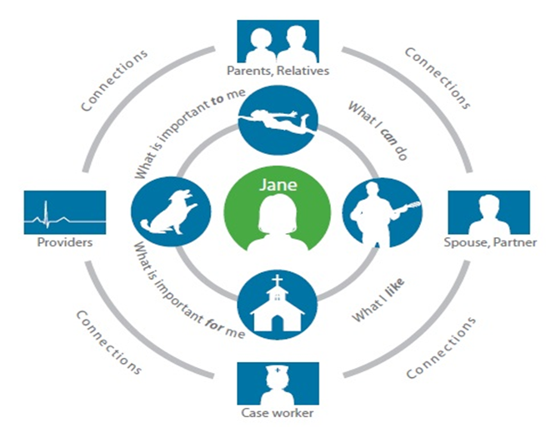
Person Centered Counseling (PCC)
Key Principles of PCC:
Focus on the individual’s goals, preferences, and strengths
Promote informed choice and self-direction
Provide unbiased information about available options
Support access to community-based services when possible
Notes:
What PCC Looks Like During a Call
Ask questions to understand the caller’s situation
Provide options rather than directing the caller to one solution
Respect the caller’s decisions
Offer information that helps the caller decide what works best for them

Slide 4
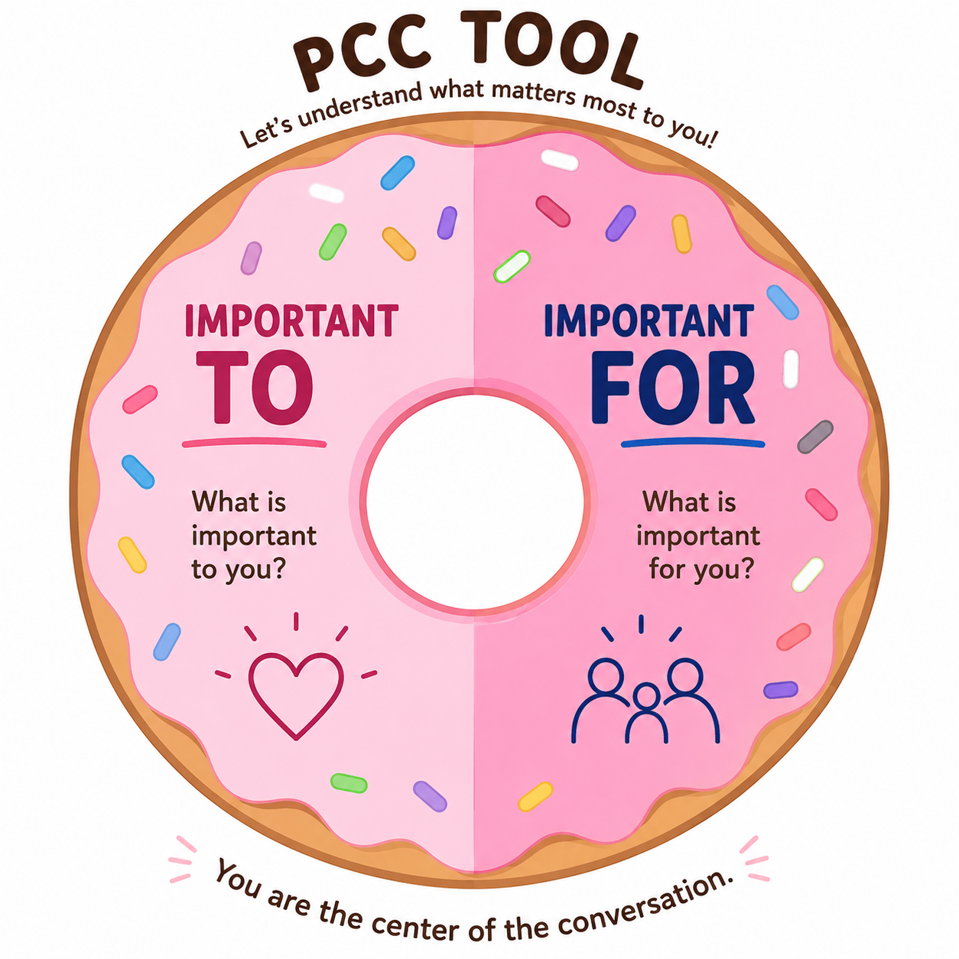
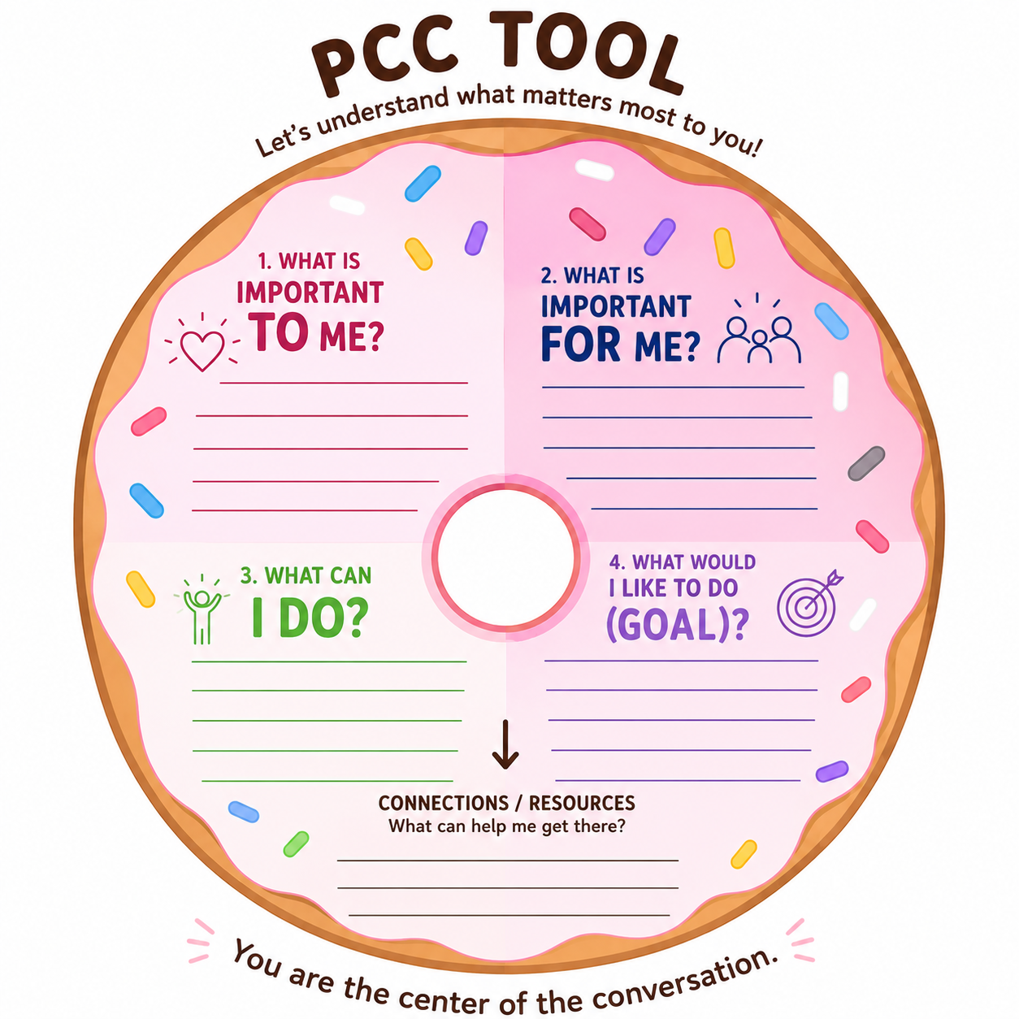
The Conversation Donut
Notes:
Remember – Donut forget me!!!
By using this donut tool, the consumer is placed in the center and staff member can help individual sort out what is important to the individual and what is important for the individual.
This helps the individual prioritize needs, wants and help them understand what their goal may be.

Slide 5
Remember – Donut forget me!!!
By using this donut tool, the consumer is placed in the center and staff member can help individual sort out what is important to the individual and what is important for the individual.
This helps the individual prioritize needs, wants and help them understand what their goal may be.

Slide 6
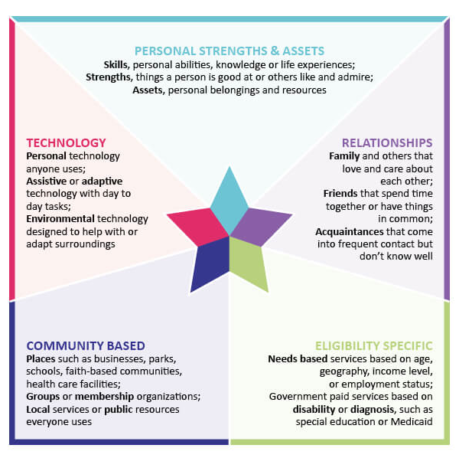
Integrated Support Star
Build upon:
Consumer’s strengths
Connections
Available supports
Identify:
Meaningful options
Resources
Next steps
Notes:
This tool helps staff identify the consumer’s existing strengths, natural supports, and available resources to support person-centered planning and informed decision-making.
Key Areas to Explore
Personal Strengths & Assets
Skills, experiences, interests, abilities, and personal resources
Relationships
Family, friends, neighbors, caregivers, and informal supports
Community-Based Supports
Local programs, organizations, faith communities, public resources, and everyday community connections
Technology
Personal devices, assistive technology, and tools that support independence and communication
Eligibility-Specific Services
Programs and services tied to eligibility requirements, diagnoses, income, age, or insurance
Goal:
To build upon the consumer’s strengths, connections, and available supports to identify meaningful options, resources, and next steps.

Slide 7
This tool helps staff identify the consumer’s existing strengths, natural supports, and available resources to support person-centered planning and informed decision-making.
Key Areas to Explore:
Personal Strengths & Assets
Skills, experiences, interests, abilities, and personal resources
Relationships
Family, friends, neighbors, caregivers, and informal supports
Community-Based Supports
Local programs, organizations, faith communities, public resources, and everyday community connections
Technology
Personal devices, assistive technology, and tools that support independence and communication
Eligibility-Specific Services
Programs and services tied to eligibility requirements, diagnoses, income, age, or insurance
Goal:
To build upon the consumer’s strengths, connections, and available supports to identify meaningful options, resources, and next steps.

Slide 8
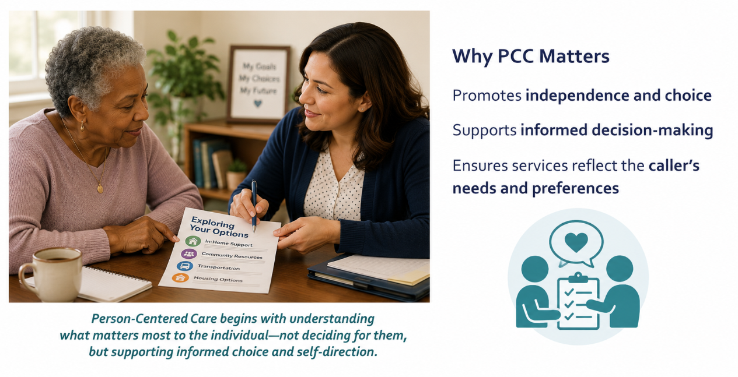
Why PCC Matters
Why PCC Matters
Promotes independence and choice
Supports informed decision-making
Ensures services reflect the caller’s needs and preferences

